Slide 1

Boring but Brilliant: Data Quality is actually the Secret Sauce for Gen AI and Intelligent Automation.
(Since its Boring can we Automate it? A Simple 3 Step Framework…)

Slide 2
Simple 3 Way Automated DQ Framework
Know
Know your Data (Observability)
Data Quality Metrics:
Continuous Monitoring:
Alerts and Notifications:
Understand
Understand your Data (Data Due Diligence)
Data Profiling:
Data Validation:
Data Lineage:
Heal
Heal your Data (Self healing & Remediation)
Data Cleansing:
Automated Workflows:

Slide 3
Automated DQ Framework (Detail with Databricks features)
Know your Data (Observability)
Data Quality Metrics:
Define and calculate data quality metrics, such as data completeness, data accuracy, and data freshness.
Use Databricks' built-in metrics or create custom metrics using SQL or Python.
Continuous Monitoring:
Continuously monitor data quality using Databricks' built-in monitoring features
Alerts and Notifications:
Set up alerts and notifications using Databricks' built-in alerting features
Understand your Data (Data Due Diligence )
Data Profiling:
Use Databricks' built-in data profiling features to analyze data distribution, patterns, and anomalies.
Calculate statistical measures like mean, median, and standard deviation to understand data characteristics.
Data Validation:
Define data validation rules using Databricks' built-in validation functions or create custom UDFs (User-Defined Functions).
Validate data against predefined rules, such as data type checks, range checks, and pattern checks.
Data Lineage:
Use Databricks' data lineage features to track data provenance and data movement.
Understand data origin, transformation, and consumption to identify data quality issues.
Heal your Data (Remediation)
Data Cleansing:
Use Databricks' data cleansing features to handle invalid or inconsistent data.
Implement data normalization, data standardization, and data imputation techniques.
Automated Workflows:
Create automated workflows using Databricks' Jobs
Schedule data quality checks, data validation, and data cleansing tasks to run at regular intervals.
Identify data quality issues in real-time and trigger automated workflows for correction.
Notify data stakeholders of data quality issues, anomalies, or changes in data distribution.

Slide 4
Know your Data
(Observability)

Slide 5
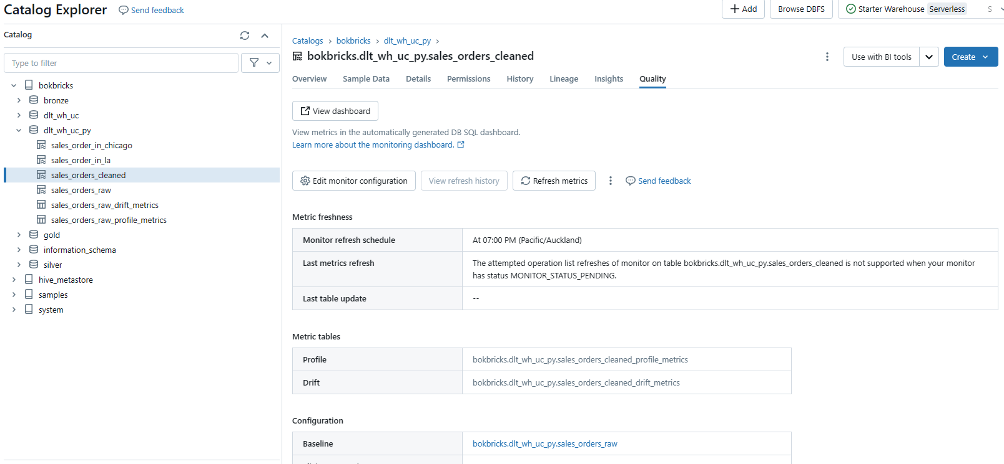
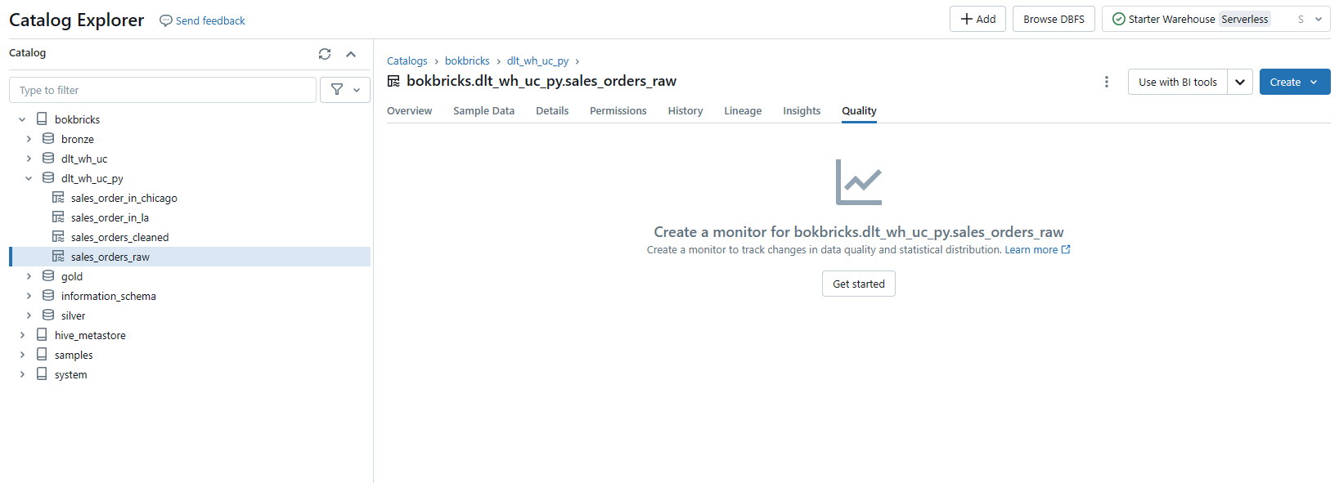
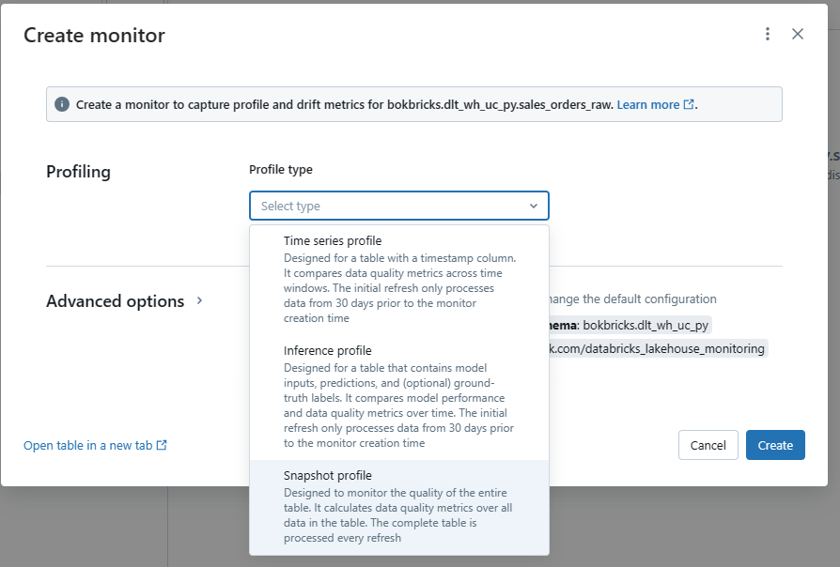
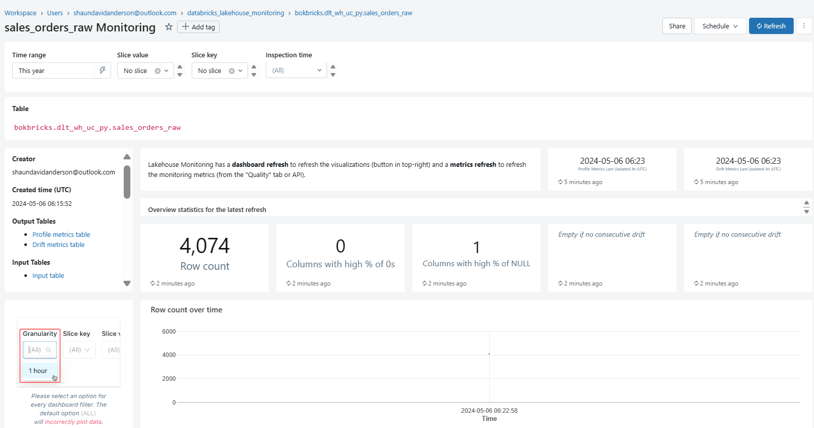
Creating a Monitor
3. Overview with links to Dashboard
In 1, 2, 3…
1. start
2. Choose type, schedule & create
4. Detailed Dashboard

Slide 6
Understand your Data
(Data Due Diligence)

Slide 7
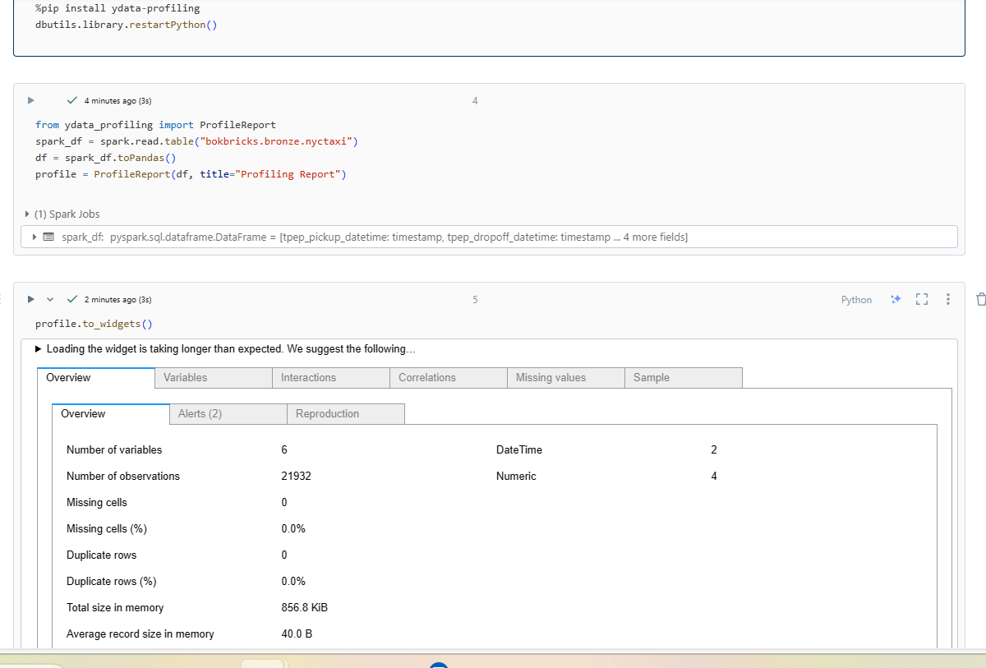
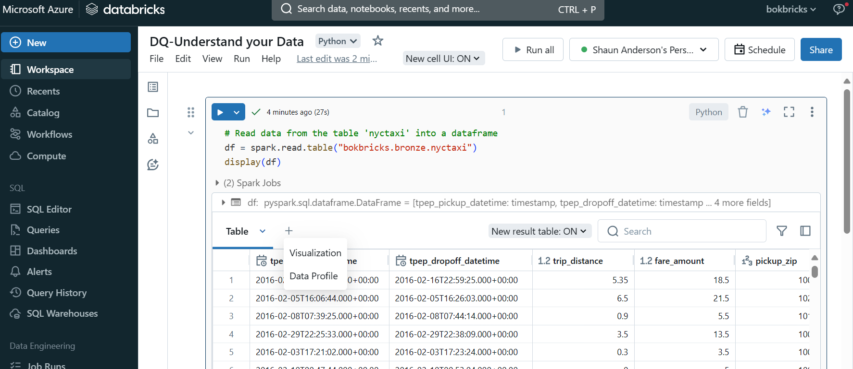
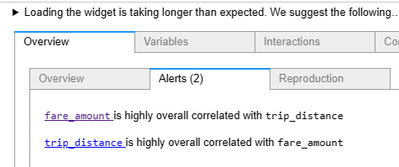
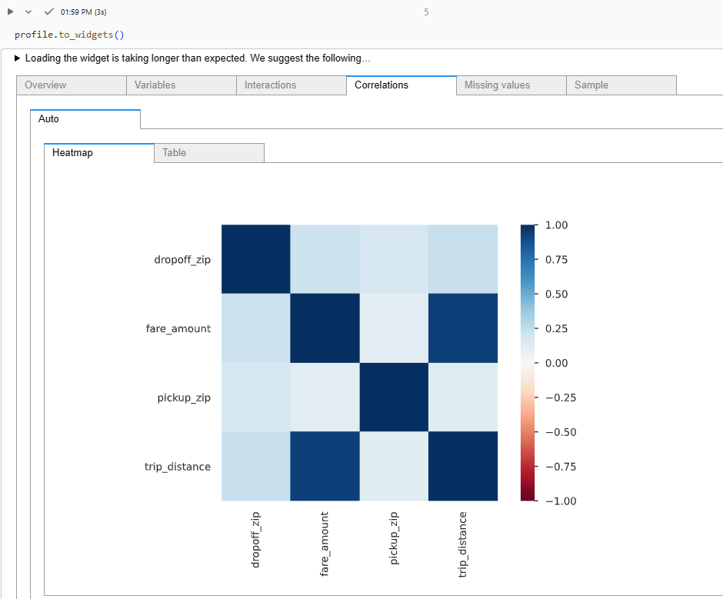
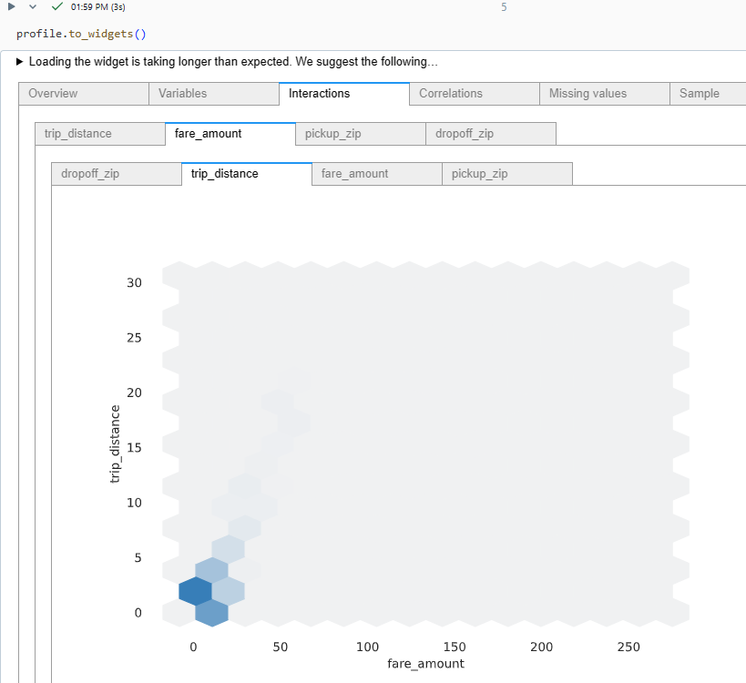
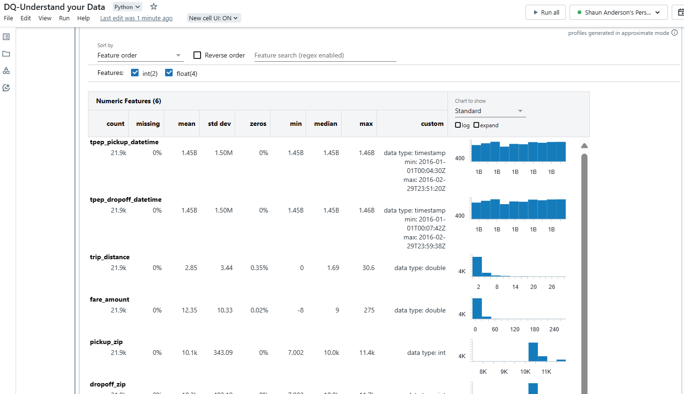
Data Profiling
Data profiles in a Databricks Notebook
AutoML (In built pandas profiling, below is the automation with ydata-profiling & output, incl alerts)
Dbutils (same as profiles, but you can automate
with command: dbutils.data.summarize(df) )

Slide 8
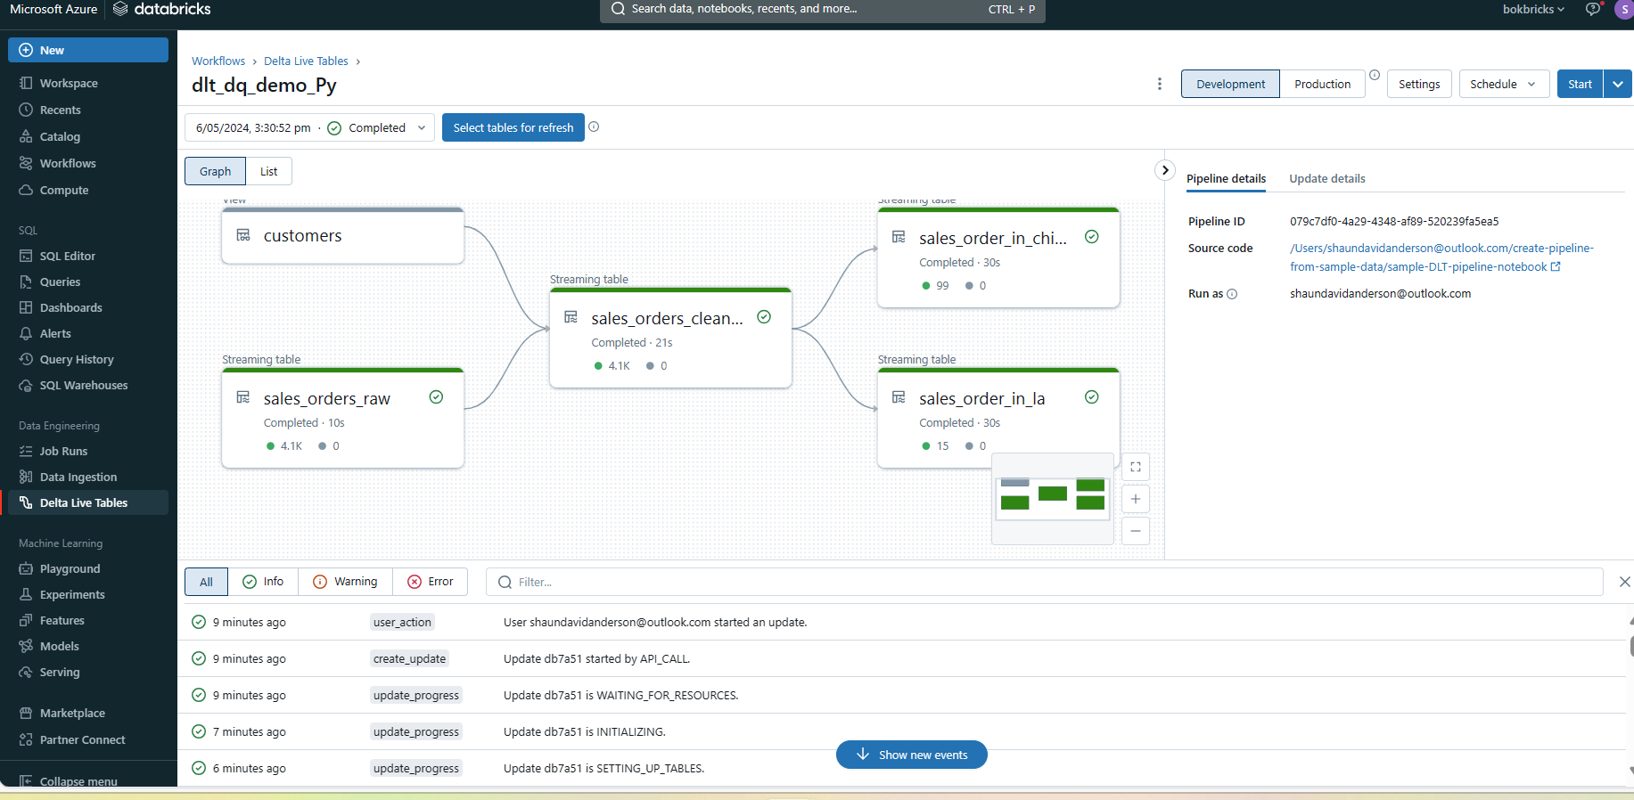
Data Validation
In Databricks, you can validate data against predefined rules using Delta Live Tables expectations. These expectations allow you to define data quality constraints on the contents of a dataset. Here’s how you can explore achieving this:
What are Delta Live Tables Expectations?
Expectations are optional clauses that you add to Delta Live Tables dataset declarations.
They apply data quality checks on each record passing through a query.
An expectation consists of three components:
Description: Acts as a unique identifier and allows you to track metrics for the constraint.
Boolean Statement: Always returns true or false based on some stated condition.
Action: Specifies what to do when a record fails the expectation (i.e., when the boolean returns false).
Actions for Invalid Records:
You can apply different actions to invalid records:
Warn (Default): Invalid records are written to the target, and failure is reported as a metric for the dataset.
Drop: Invalid records are dropped before data is written to the target.
Fail: Invalid records prevent the update from succeeding, requiring manual intervention before re-processing.
Advanced Usage:
You can maintain data quality rules separately from your pipeline implementations.
Store rules in a Delta table categorized by tags.
Use these tags in dataset definitions to determine which rules to apply.
Examples (dlt decorators in python):
Retain invalid records:
@dlt.expect("valid timestamp", "col(\"timestamp\") > '2012-01-01'")
Drop invalid records:
@dlt.expect_or_drop("valid_current_page", "current_page_id IS NOT NULL AND current_page_title IS NOT NULL")

Slide 9
Data Lineage
Data lineage and provenance are essential for understanding data movement, ensuring data quality, and maintaining trust in your data assets. Databricks’ features provide AI enhanced visibility into these aspects, allowing organizations to make informed decisions about their data
Data Lineage
Definition: Data lineage is the visual representation of the flow of data from its origin (source) through various transformations to its final destination (consumption).
Purpose:
Understand how data moves within your organization.
Track the path of data to ensure its accuracy, reliability, and compliance.
Identify dependencies between data assets.
Components:
Source: The initial point where data originates (e.g., databases, APIs, files).
Transformations: The intermediate steps that modify or process the data (e.g., ETL jobs, data pipelines, transformations).
Destination/Consumption: The final location where data is used (e.g., reports, dashboards, machine learning models).
Data Provenance:
Definition: Data provenance focuses on documenting the historical record of data. It provides information about the data’s origin, ownership, and changes over time.
Purpose:
Ensure data authenticity and trustworthiness.
Trace back to the original source of data.
Understand the context and history of data.
Components:
Metadata: Information about data, including its source, creation date, and any transformations applied.
Audit Trails: Records of data changes, access, and usage.
Versioning: Tracking different versions of data.
Databricks’ Data Lineage Features:
Unity Catalog: Databricks provides Unity Catalog, which captures runtime data lineage across queries run on Databricks.
Granularity: Lineage is captured down to the column level.
Visualization: Lineage can be visualized in Catalog Explorer in near real-time.
REST API: You can retrieve lineage data using the Databricks REST API.
Aggregation: Lineage is aggregated across all workspaces attached to a Unity Catalog metastore.
Permissions: Users must have the correct permissions to view lineage data.
Retention: Lineage data is retained for 1 year.

Slide 10
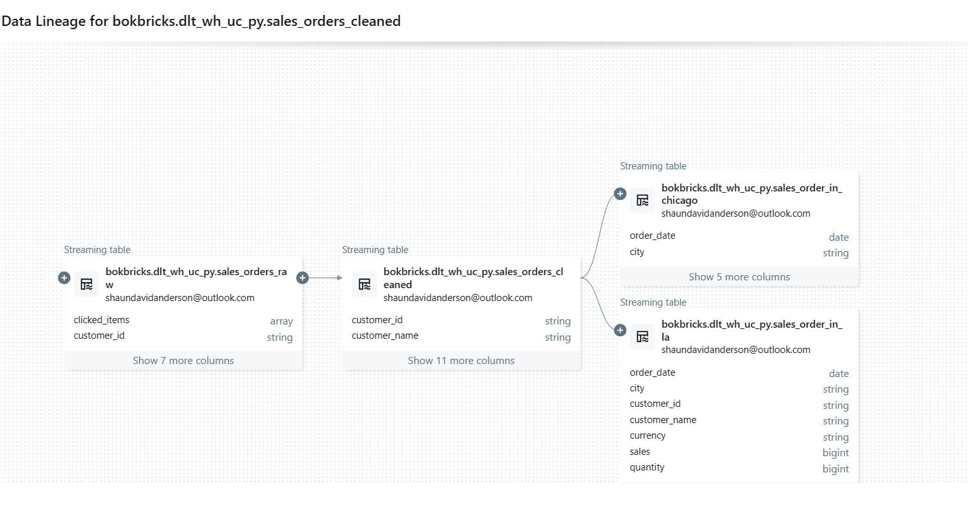
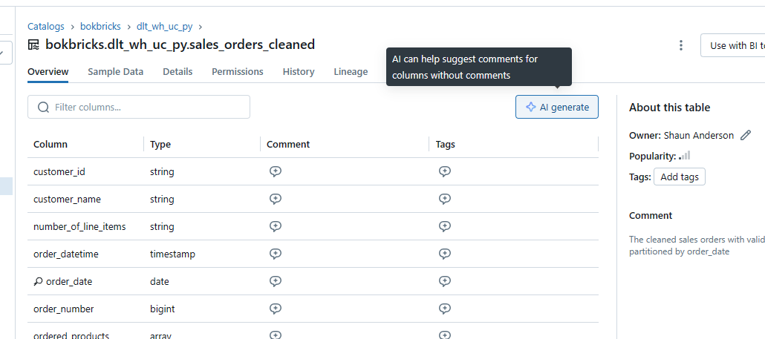
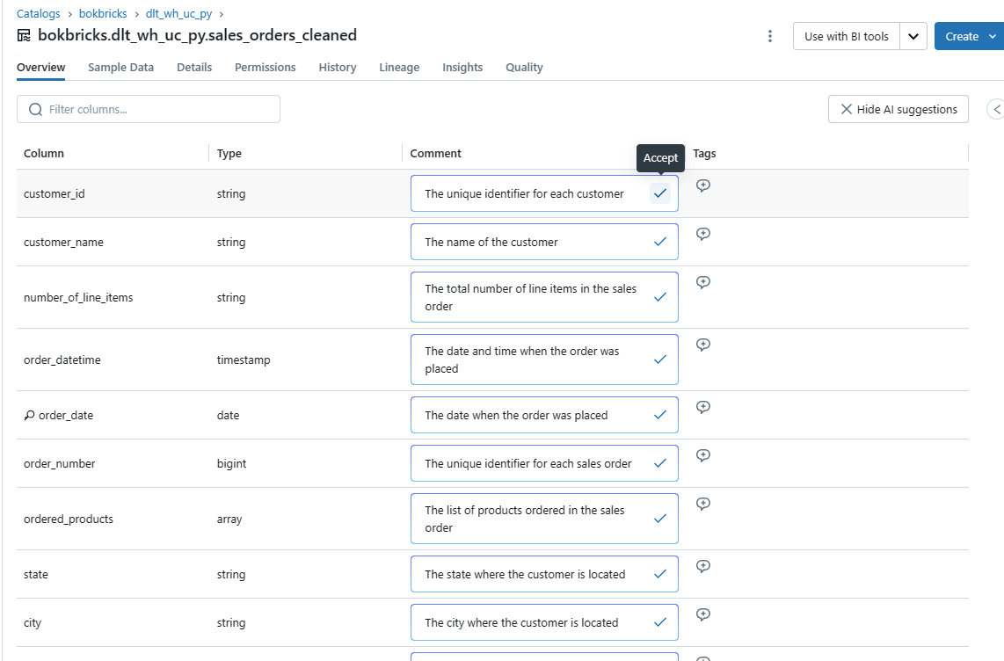
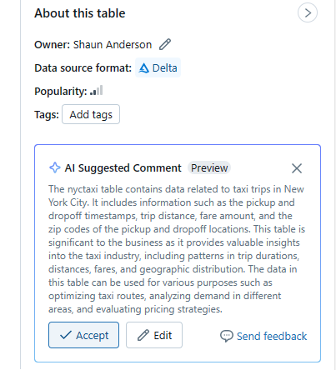
Data Lineage & Provenance
Databricks Lineage & AI Assisted Provenance Features

Slide 11
Heal your Data
(Self healing & Remediation)

Slide 12
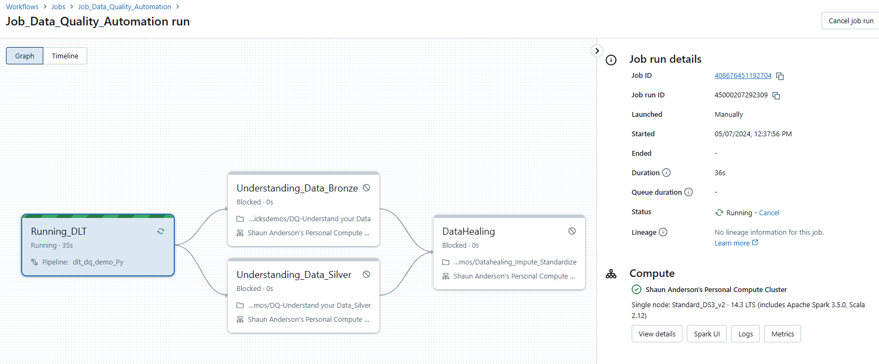
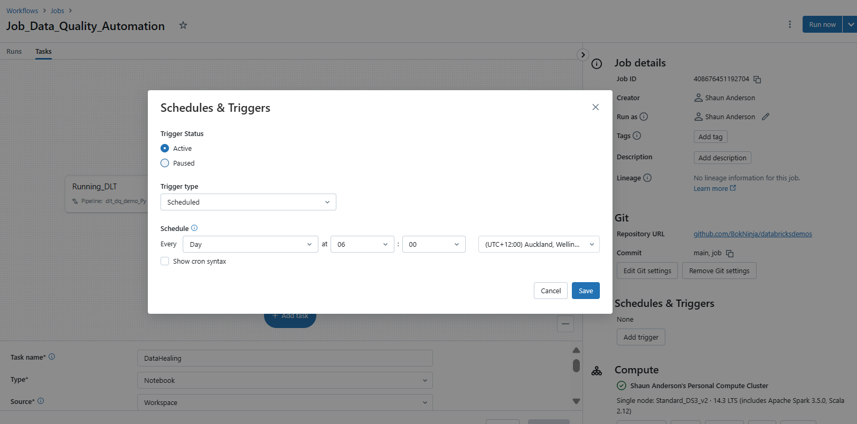
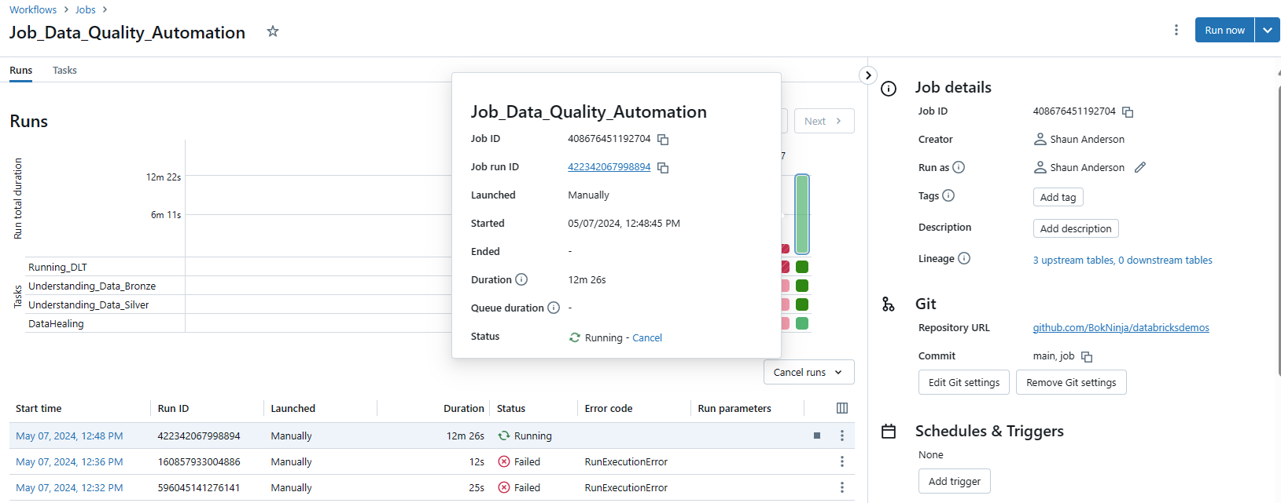
Data Quality Automation
Databricks Jobs: This is a managed orchestration service that is fully integrated with the Databricks Data Intelligence Platform. You are able to define and manage multitask workflows to automate your entire set of processes you have in place for Data Quality Management
Visual Logic of Automated
Data Quality Management
Easy to Schedule or Trigger, with full
Observability of runs,
with warnings and alerts

